Slide 1

Project Presentation Public Restroom Locator For Specially Challenged
Group Name: The Beatles
Group Number: 2

Slide 2
Group 2 - The Beatles
Name | ID
Shah, Krishna Vipul Kumar | 11653376
Valapadasu, Uday Bhaskar | 11696364
Yalamanchili, Manoj | 11698415
Gokari, Keerthi Goud | 11698406
Yamuna Reddy Dorsala | 11704805

Slide 3
abstract
Introducing the Restroom Locator for Disabled Individuals web app, addressing the vital issue of accessible restrooms for people with disabilities. This user-friendly platform utilizes Maps JavaScript API, enabling individuals to easily find nearby accessible restrooms tailored to their needs. Detailed restroom information includes key accessibility features, and users can contribute reviews, fostering a community-driven resource. The app provides real-time updates on new restroom facilities and ratings, ensuring users have the latest information. Overall, it enhances the quality of life for individuals with specific mobility needs, promoting inclusivity through an accessible and community-driven restroom locator.

Slide 4





Technology And Database Used
HTML, CSS, JS – Front end
Python – Back end – connect with data base and play with Library
SMTP – Amazon SES email service
Database and Hosting Services - Heroku

Slide 5
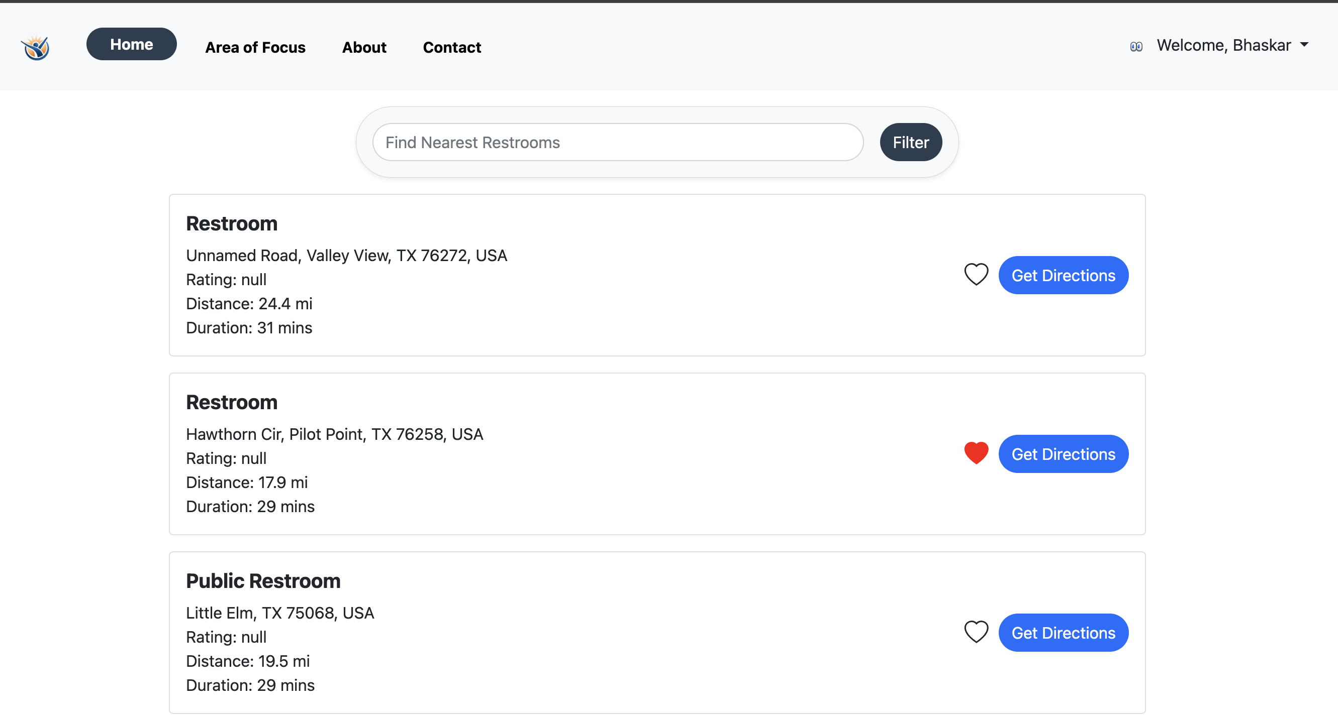
Introducing the Public Restroom Locator for Specially Challenged – a dedicated website addressing the unique restroom accessibility needs of individuals with disabilities. Find inclusive facilities with ease and enhance daily accessibility.
Access our website at :
https://agile-chamber-93508-3b4b97083fcc.herokuapp.com/

Slide 6
Existing Features

Slide 7
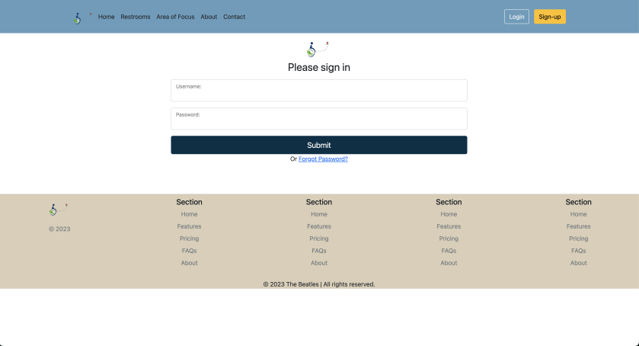
Login Screen: The login screen will ask email password to enter.

Slide 8
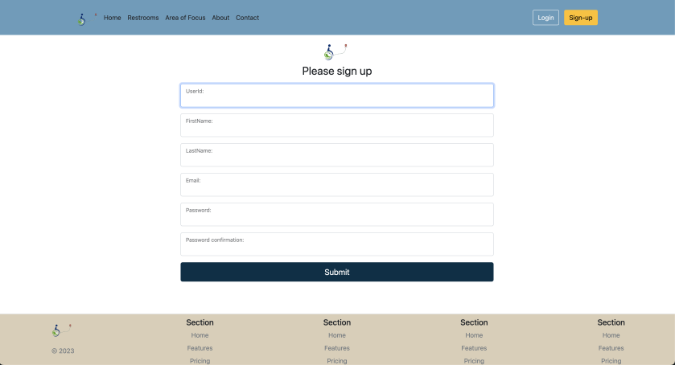
Registration Screen:
This screen will ask for the details for the registration like user id, email, password, confirm password.

Slide 9
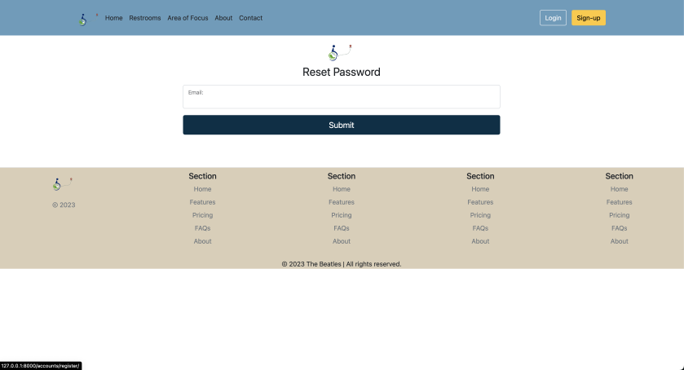
Forgot Password: User can make new password by clicking on forgot password from login screen

Slide 10
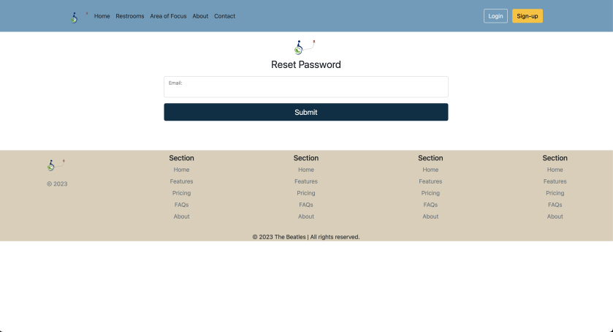
Reset Password: User can access this feature from my account

Slide 11
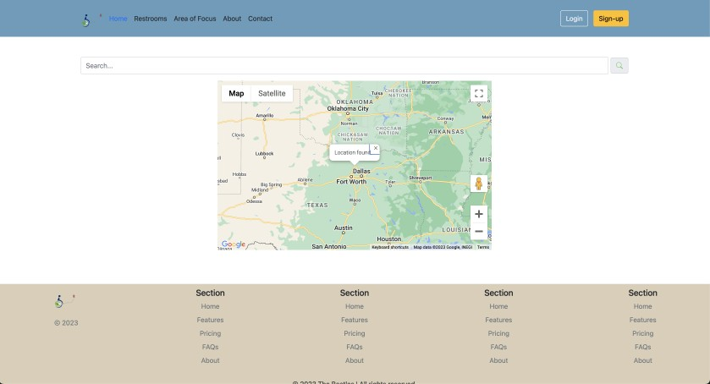
Current Location With Map: JS Map API

Slide 12
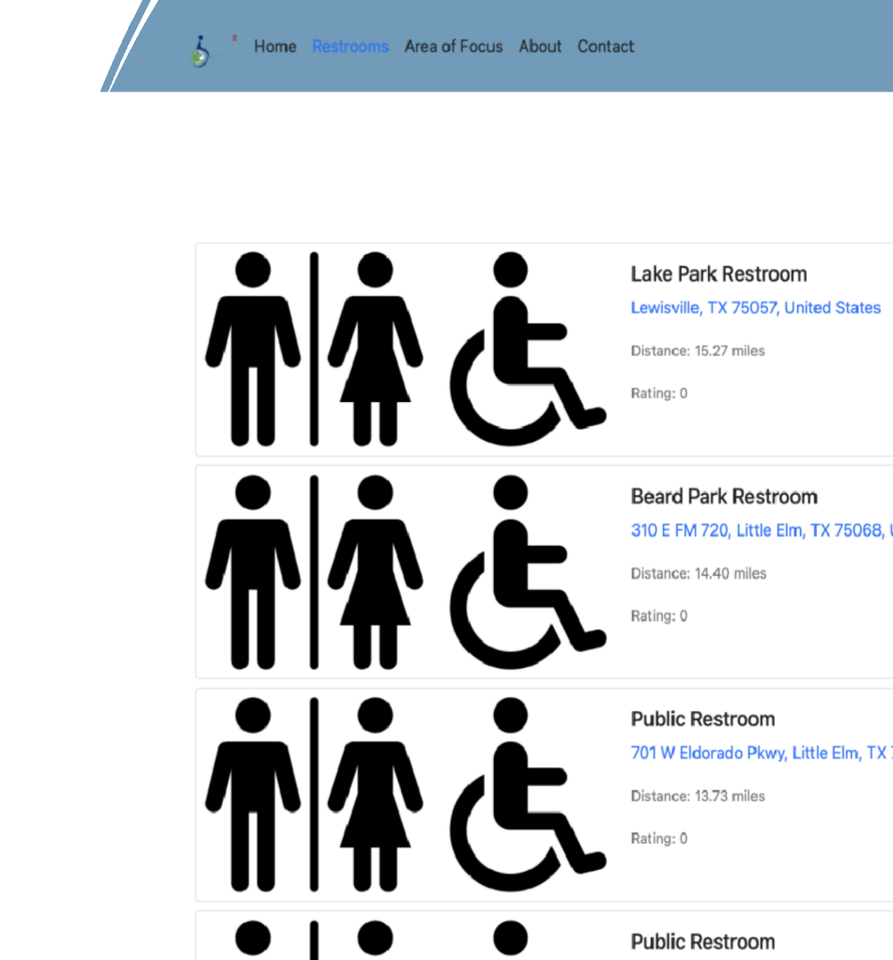
Sort By Ratings

Slide 13
Enhanced And New Features

Slide 14
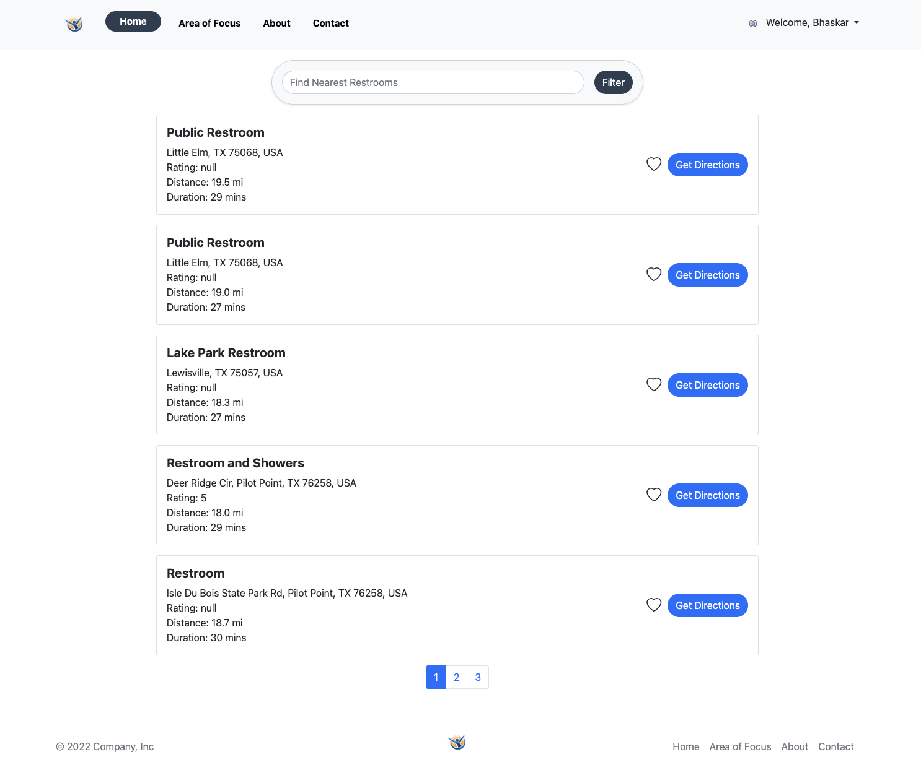
Enhanced Home Page UI Design

Slide 15
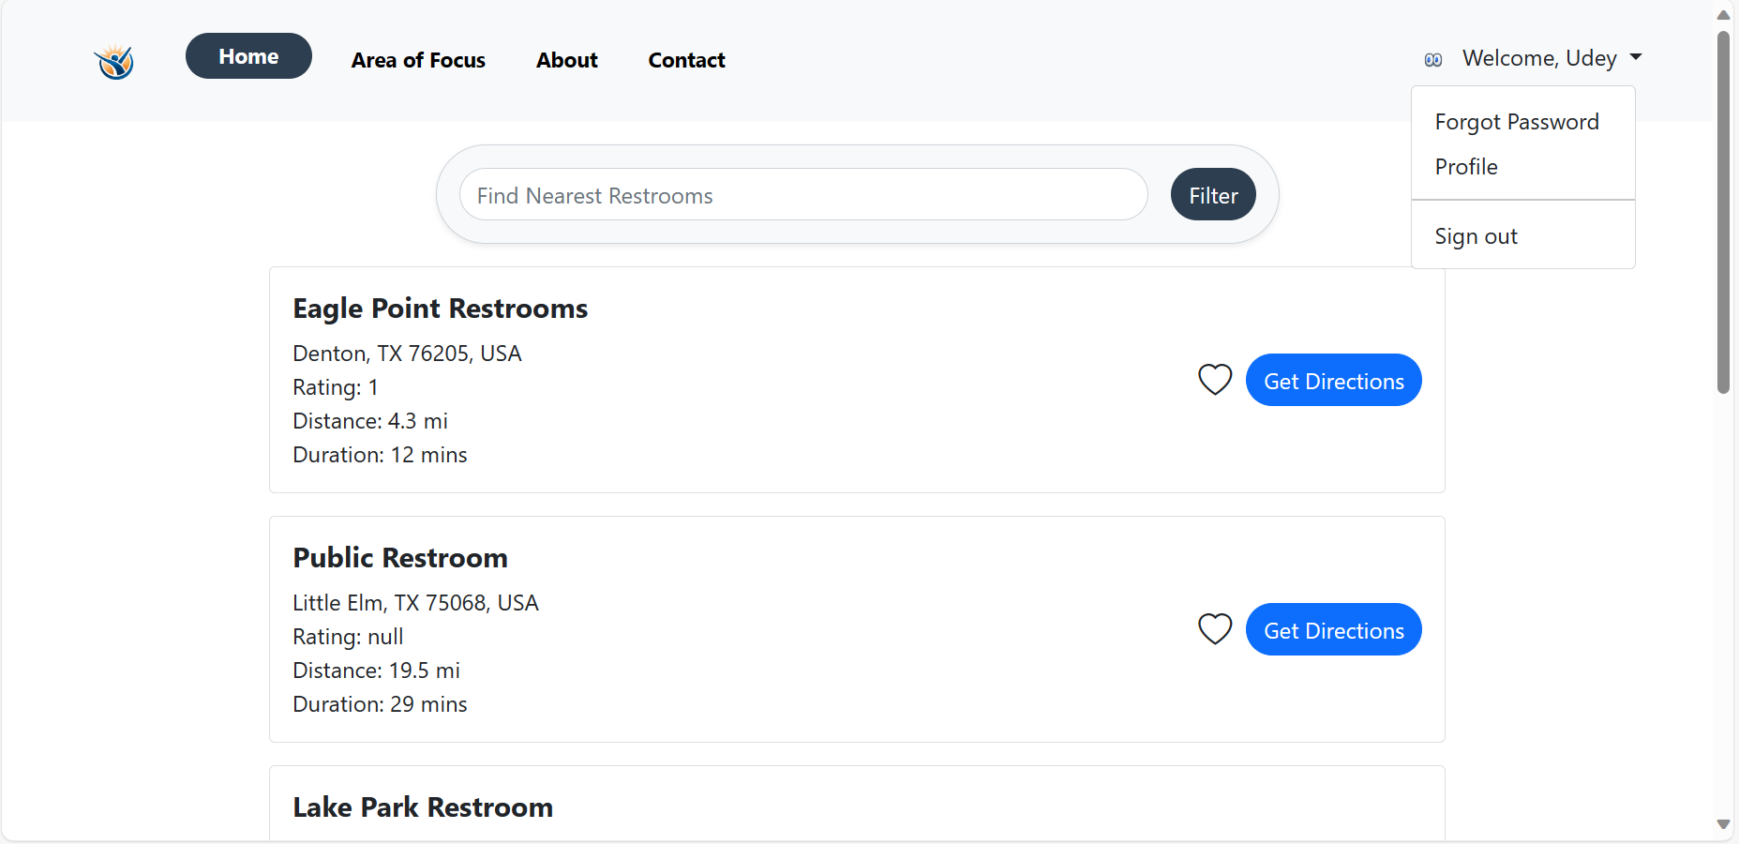
Nearby Restroom List On Dashboard
Nearby Restrooms will Appear only after user allows to give the current location.
We have added the paginations, per page 5 restroom will show.
The restroom will appear within 20,000 Radius from the current location.
The favorite Icon will add that Restroom to favorite section.
User will be able to see favorite restroom from the favorite section.

Slide 16
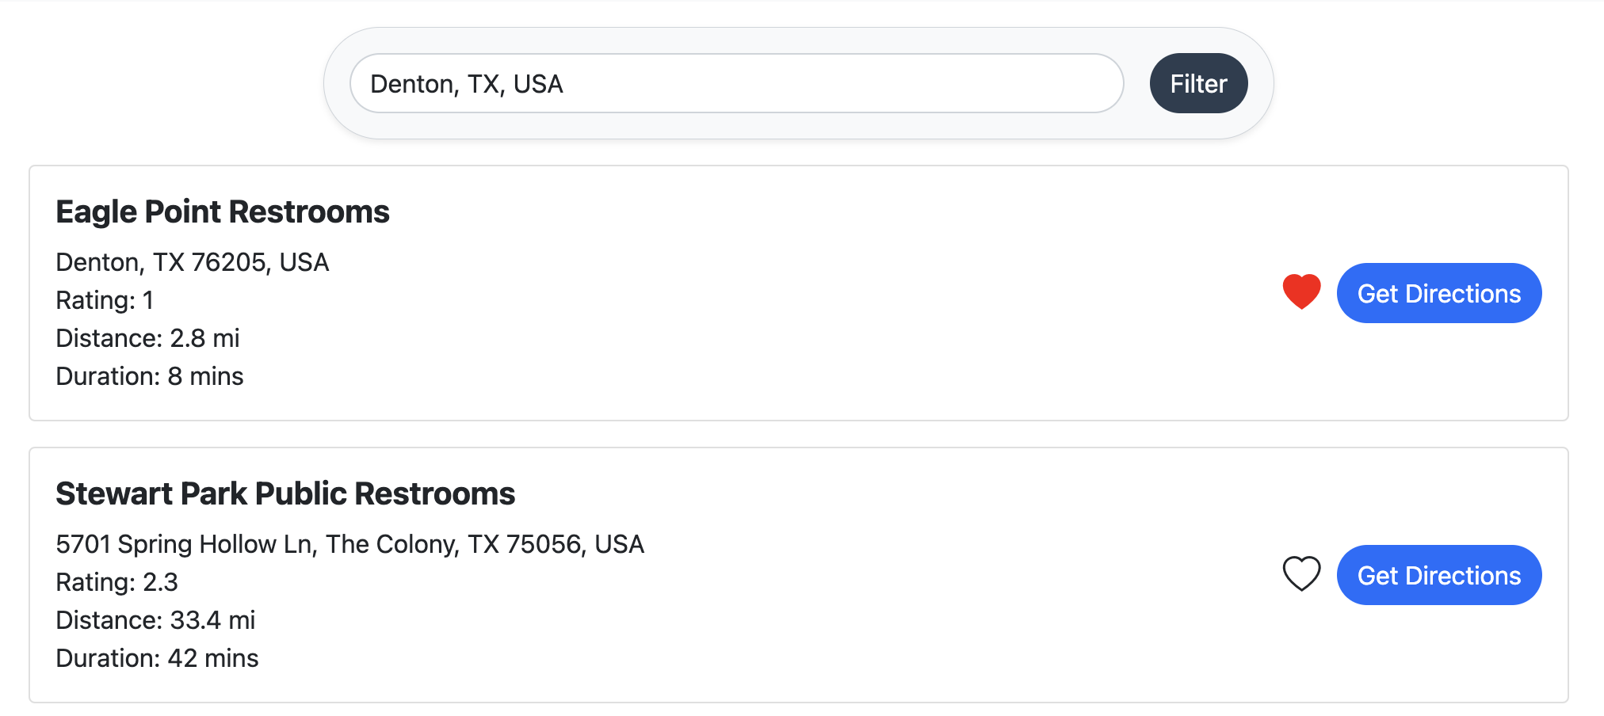
Favorite Restroom Section
From this section user will be able to manage the favorite restrooms.
The restroom will show with Red heart.
User can click on red heart and it will be removed from favorite’s list.

Slide 17
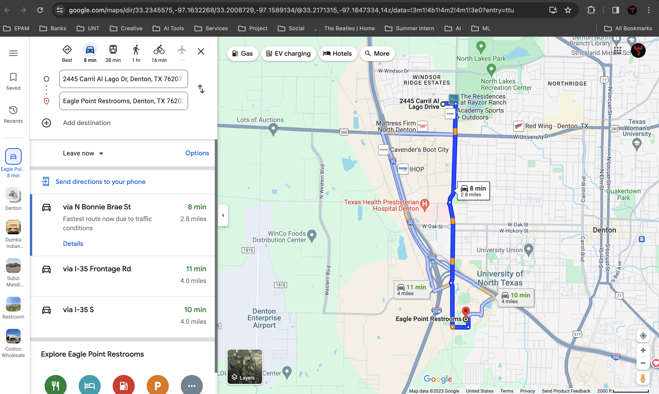
By Clicking On Get Direction Button User Will Redirect To The Google Map
- By clicking on Get Direction button user will be redirected the google Map screen from there user can get the exact location via google map.

Slide 18
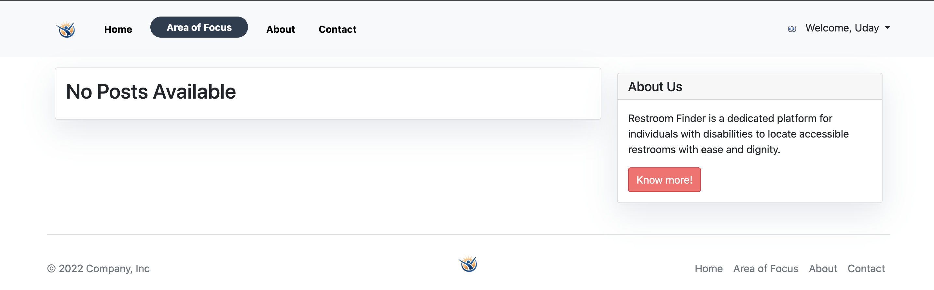
Area Of Focus
Admins only : Collects articles and blogs for users with disabilities to Inspires, educates, and builds a supportive community.

Slide 19
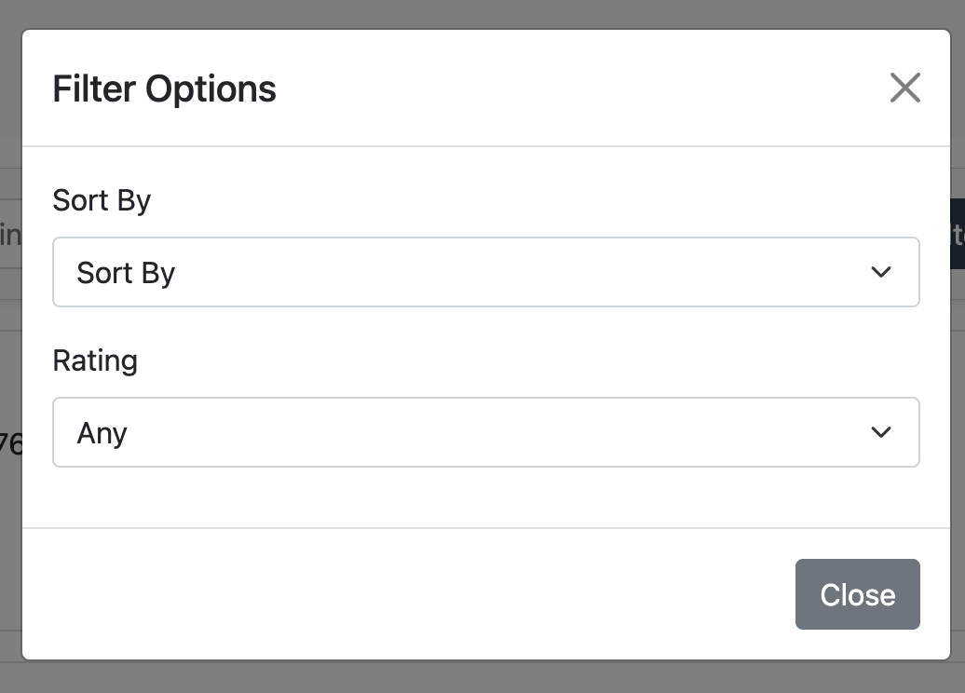
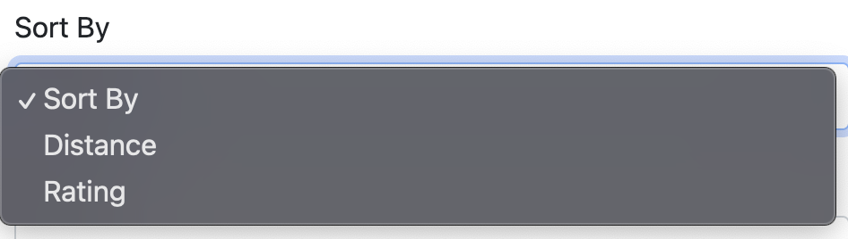
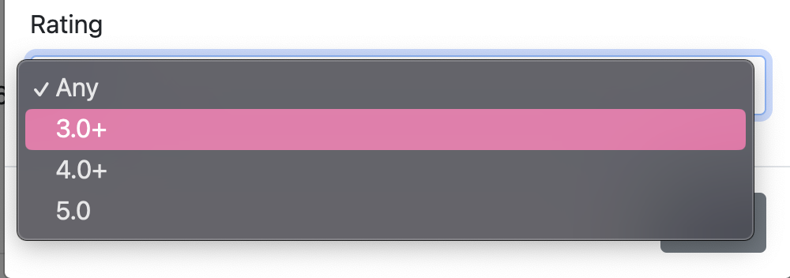
Filter Option
To sort the restroom list with reference to distance and rating
Sort By: Choose between distance and rating to organize the restroom list. Ascending order for proximity or highest rating, making it easy to find the nearest or top-rated restroom.
Rating: Sort restrooms using four options: Any, 3.0+, 4.0+ 5.0+

Slide 20
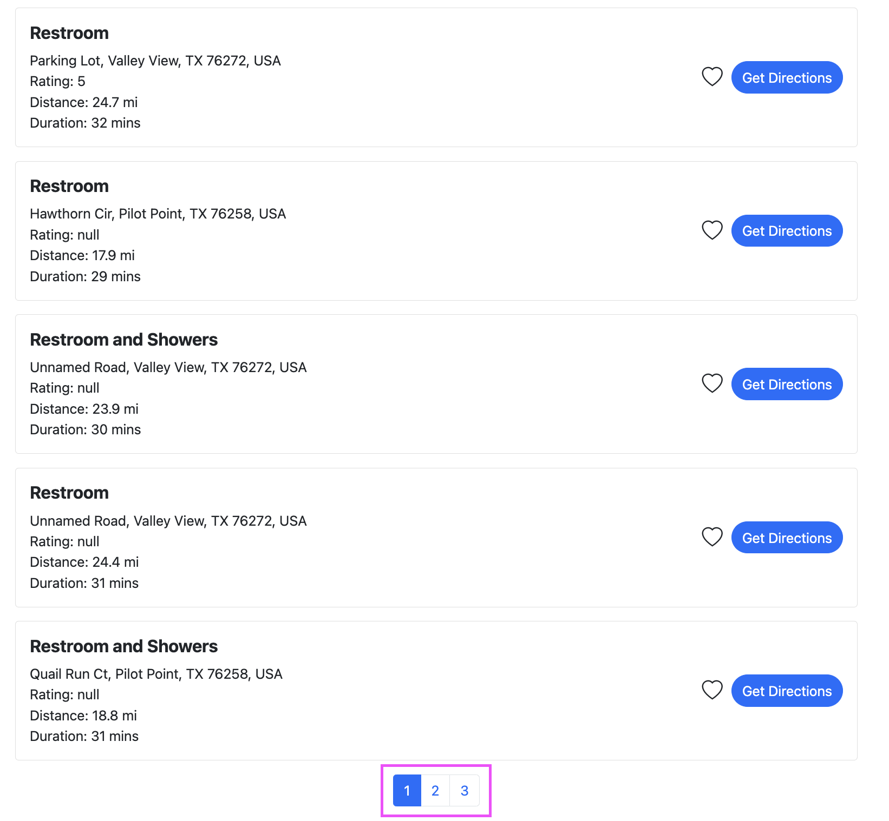
Pagination
Introduced pagination to split the restroom list into separate pages

Slide 21
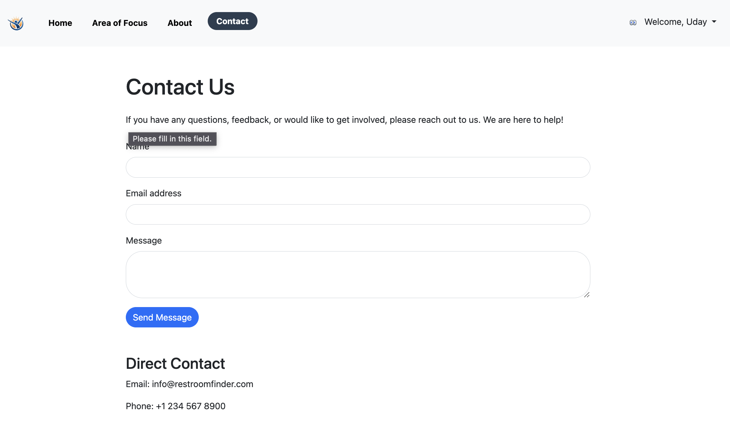
Contact Page
To get the continuous feedback on the website bugs found.

Slide 22
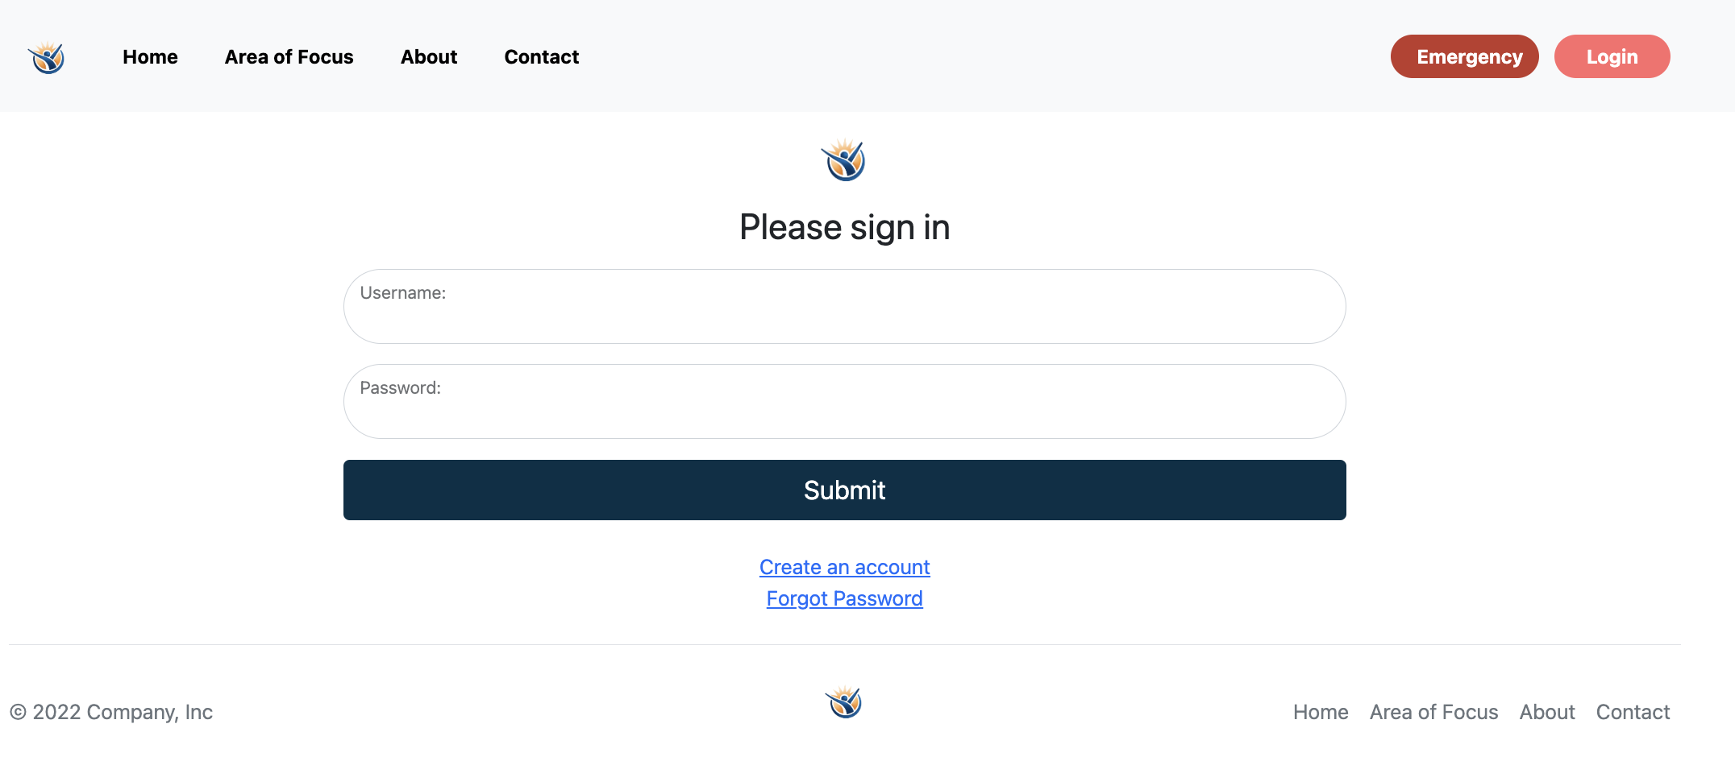
Emergency Button
Implemented an Emergency Button that, when activated, initiates a call to 911 for immediate assistance for users.

Slide 23
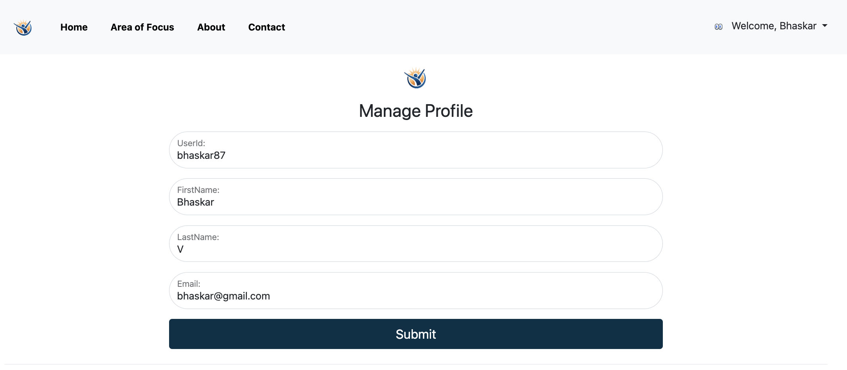
Manage Profile
Implemented a "Manage Profile" page for users to edit their personal information.

Slide 24
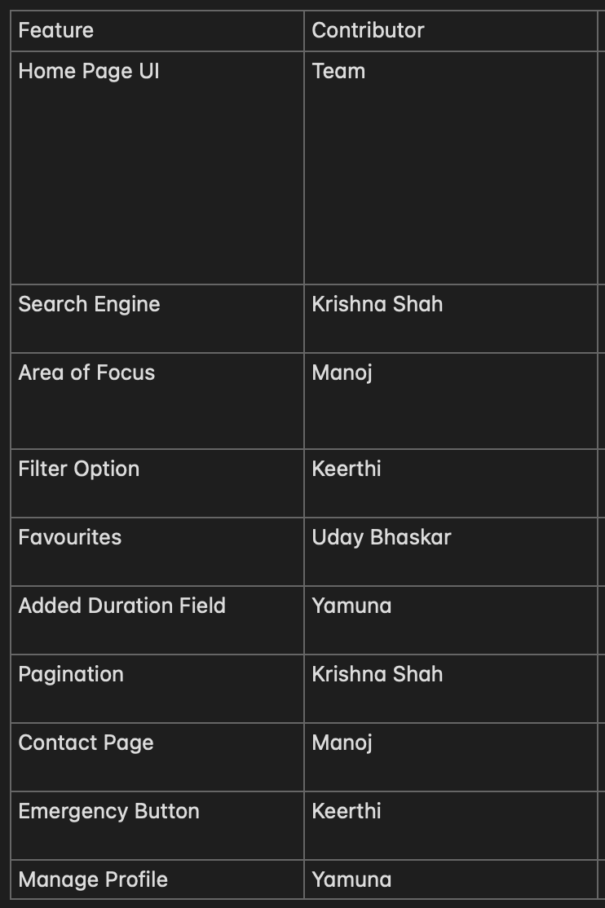
Discuss Individual Contribution

Slide 25
Thank You

